Slide 1
Psychophysics Toolbox (PTB) – a gentle introduction (part one)
How to design psychological experiments using MATLAB
Andrea Castegnaro
uceeaca@ucl.ac.uk
25 January 2022
Course material: https://moodle.ucl.ac.uk/course/view.php?id=22765

Slide 2
Motivation
Experiment design
Necessity for having an accurate and flexible control over stimulus presentation (e.g. visuals and auditory)
Robust timing for stimulus presentation and response collection
Requires low-level programming operations: usually made using C++ for managing periphericals (e.g. keyboard) and sound, or using OpenGL for managing graphics libraries to display shapes/images/video
Psychophysics Tool Box (PTB) is a mid-level layer providing an application programming interface (API) to perform low-level operations in friendly way
Available for Matlab and GNU Octave
A sub-set is available as a Python package (https://www.psychopy.org/)
Alternatives: E-prime (paid), Cogent (deprecated)

Slide 3

PTB Resources
Main webpage: http://psychtoolbox.org/
Main documentation: http://psychtoolbox.org/docs/PsychBasic
Tutorials: https://peterscarfe.com/ptbtutorials.html
Community forum: https://psychtoolbox.discourse.group/
Stack overflow: https://stackoverflow.com/
(Tip: use square-brackets for specific tags)

Slide 4

Installation
Guide: http://psychtoolbox.org/download.html
Requirements
MAC – macOS 10.11 “El Capitan” to macOS 10.15.
Windows – Windows 10
Minimum OpenGL 2.1 supported. Some limitation on graphics cards available (AMD is preferred over NVIDIA)
See full list on http://psychtoolbox.org/requirements.html
In short
Remove previous installation (if any)
>> PsychtoolboxVersion
MAC
Windows
Download installer
Download installer
Install GStreamer (if video streaming is needed)
Install Microsoft Runtime Libraries
>> cd “path to download installer”
>> DownloadPsychtoolbox
>> cd(“path to download installer”)
>> DownloadPsychtoolbox(‘C:\toolbox’)

Slide 5

Useful tips (1)
Opening a transparent window in PTB letting mouse clicks to go beyond the PTB window (useful when working on a single screen to access Matlab)
PTB windows do not automatically close when errors are encountered in your scripts. That means you may need to force close the PTB window.
MAC: command + period; command + 0; type “sca” on command window;
Windows: ctrl+alt+del → terminate window / alt+tab to matlab; ctrl+c; type “sca” on command window
Type “help functionName” for getting high level description of any API
E.g.
Some PTB functions are nested with sub-functions. Type “functionName subFunctionName?” for getting a description of sub-functions
E.g.
PsychDebugWindowConfiguration(0,0.5);
>> help Screen
>> Screen OpenWindow?

Slide 6
Useful tips (2)
Try/catch statement is your best friend here
try
% Try block is where the normal code will be executed
catch ME
% If an error is raised then the execution does not terminate, the error will be ‘catched’ and only then the catch block will be executed. ME is a struct containing all the information about the error raised in the try block.
This gives us the possibility to safely close the PTB window by doing
sca; %Screen('CloseAll’);
% Usually we want to understand what error we encountered so we ‘rethrow’. This will make the script execution to stop and the error will be placed in the command window (as usual)
rethrow(ME);
end

Slide 7

The ‘Screen’ function
Controls how graphical objects are displayed the screen (shapes, images)
Typing give a list of all the commands available with the Screen function
Every time we “draw” using ‘Screen’ we interact with the back-buffer (imagine it as a virtual copy of our PTB window).
>> Screen
Each time we want to display what we are drawing in the back-buffer to the PTB window we have to call a specific Screen subfunction (‘Flip’).
The function will place the objects on the back-buffer to the front-buffer and at the same time will clear the back-buffer enabling us to prepare the next screen.
Back-buffer
Front-buffer (screen)
Screen('Flip’,window);

Slide 8
The ‘Screen’ function
The reason ‘flipping’ cannot happen at any time is because it needs to happen accordingly to the refresh capability of the monitor.
Refresh rate is measure in Hz indicating how many refreshes a monitor can make in a second.
When flipping the back-buffer using Screen(‘Flip’), PTB automatically try to sync the operation between the end of the previous refresh and the beginning of the following one, by automatically performing some testing operation anytime a PTB window is opened on a screen.
When this operation fails you may risk to show only a portion of the current image.
This operation is part of a legacy for when PTB was developed on older monitors. Nowadays, it can be skipped if the experimental setup in reasonably recent, using
Screen('Preference', 'SkipSyncTests', 1);
Back-buffer
Refresh Time 1
Front buffer (screen)
Refresh Time 2 > RefreshTime1
Front buffer (screen)
Screen('Flip’,window);

Slide 9
The ‘Screen’ function
When drawing any object (shapes/images/text) to the back-buffer we go always from the background to the foreground
For example if we want to draw a green triangle in front of a blue circle on a gray background, we should perform the following steps
Step One
–
drawing a background
Step Two
–
drawing the circle
Step three
–
drawing the triangle
Back-buffer
Back-buffer
Back-buffer

Slide 10
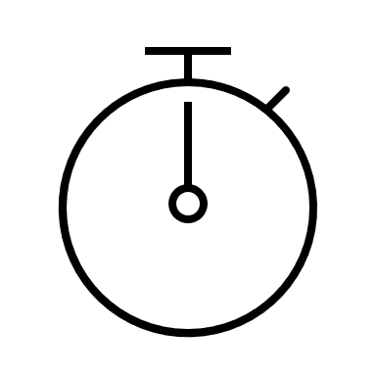
Basic timing
Sometimes an object has to be displayed for a fixed amount of time in the screen. We can stop the execution of any script by doing
realTimeSeconds = WaitSecs(nSeconds);
Time in seconds since the start of the script execution
Time in seconds we want to wait script execution
To instead getting the time at a specific point in the script execution
realTimeSeconds = GetSecs;

Slide 11

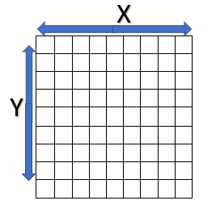
Opening a window - examples 1/2
Opening a window requires initialization of graphics (e.g. checking OpenGL availability), peripherals (e.g. keyboard), audios. This can be easily performed by doing
PsychDefaultSetup(2);
After initialization we can safely open a PTB window
[PTBwindow, sourceRect] = PsychImaging('OpenWindow’, screenNumber, [0 1 0], screenRect]);
Returns a pointer to the PTB window. This is necessary to instruct future drawing to display on this specific window
Returns the dimension in pixels of the opened PTB window. It is defined as [0 0 xend yend]
A number [0..n] indicating the screen where we want to place our PTB window
is defined as [xstart ystart xend yend] in screen coordinates
(0,0)
PTB window
[R G B]
or
[R G B A]
Background color as an RGB or RGBA value. RGB is a triplet of number [0..1] indicating the magnitude of each channel of the overall color.
A(alpha) is a number [0..1] indicating how transparent the object will be on the screen - i.e. allow the possibility to see objects that are drawn beneath this one.
A value of 1 indicates no transparency and a value of 0 will draw an invisible window.

Slide 12

Drawing shapes – example 3/4
Drawing a simple line
Screen('DrawLine’, PTBwindow, [1 1 1], xstart, ystart, xend, yend, width);
the pointer to the PTB window where we want to draw our line
Define the start and end pixels of the line in PTB window coordinates
[R G B]
OR
[R G B A]
(0,0)

Slide 13
Drawing shapes – example 5/6
Drawing a rectangle
Screen('FillRect’, PTBwindow, [0 1 0], shapeRect)
the pointer to the PTB window where we want to draw our line
shapeRect is defined as [xstart ystart xend yend] in PTB window coordinates
Define a rectangle as top left corner and bottom right corner
[R G B]
OR
[R G B A]
(0,0)
A is the alpha channel of the color. Ranged [0..1] indicates how transparent the object will be on the screen i.e. allow the possibility to see objects that are drawn beneath this one.
A value of 1 indicates no transparency and a value of 0 will draw an invisible object on the screen
[2 2 5 8]

Slide 14

Drawing images – example 7/8
Drawing requires an asset to be loaded as in image into Matlab
Can be png or jpg
Drawing an image on a PTB window requires more steps
Load the image from a file which returns a multidimensional array representing for each image pixel the RGB value
Create an holder that can be used by PTB to recognize the image. The holder is a texture object
Finally we can instruct PTB to write the texture into the back-buffer
currImage = imread(‘./pathToYourFile.png');
imageTexture = Screen('MakeTexture', window, currImage);
Screen('DrawTexture', window, imageTexture, sourceRect, destinationRect);
sourceRect define a rectangle area indicating the portion of the texture we want to use for drawing. Default is empty [] and will draw the entire texture
destinationRect is a rectangle indicating the portion of the PTB window where to draw the texture. Texture will be rescaled accordingly. Default is empty [] and will draw the texture at the center of the screen

Slide 15

Drawing text – example 9
For drawing text
startX, startY are window coordinates from which the text will be displayed character by character
[newX, newY] are the coordinates of the cursor after the last drawn character. Getting the final cursor might be useful when wanting to display more text in more than in ‘flip’.
Alternatively,
allow special character for startX (‘center’,’left’, ’right’) to justify the text at the center, left or right of the window. For startY only ‘center’ justification is allowed.
wrapAt indicate the number of characters after which the text will be displayed on a new line.
bbox are the coordinates of the rectangle that enclose the entire text, useful to display obejcts around the text
[newX,newY] = Screen('DrawText’, PTBwindow, textToDisplay, startX, startY, [0 0 0]);
[newX, newY, bbox] = DrawFormattedText(window, textToDisplay, startX, startY, [0 0 0], wrapAt);

Slide 16

Reading keyboard – example 10
Waiting for a keyboard press. This function stop the execution of the current script waiting for a keyboard press
KbWait;
To query any status change of the peripherals (key press/release/holding down) we can use
[keyIsDown, secs, keyCode] = KbCheck;
A number indicating whether the key is been pressed 0 or release the pointer to the PTB window where we want to draw our line
The time in seconds since the start of the script when KbCheck returns the status
keyCode is a 256 elements number array. Each position indicates the number with a 0 or 1 the index of the key for which a status change is being detected

Slide 17
Reading keyboard – example 10
To check the current key indices – key names mapping PTB uses for a system you can simply write
KbName('KeyNames')
To check a single association between key name and key code you can run the same by providing either or the other.
nameOrCode = KbName(keyCodeOrKeyName);
This KbName has a flexible return meaning that if provided with a number as an input will return the name of the corresponding key and if provided with a name will return a number indicating the code for that name

Slide 18
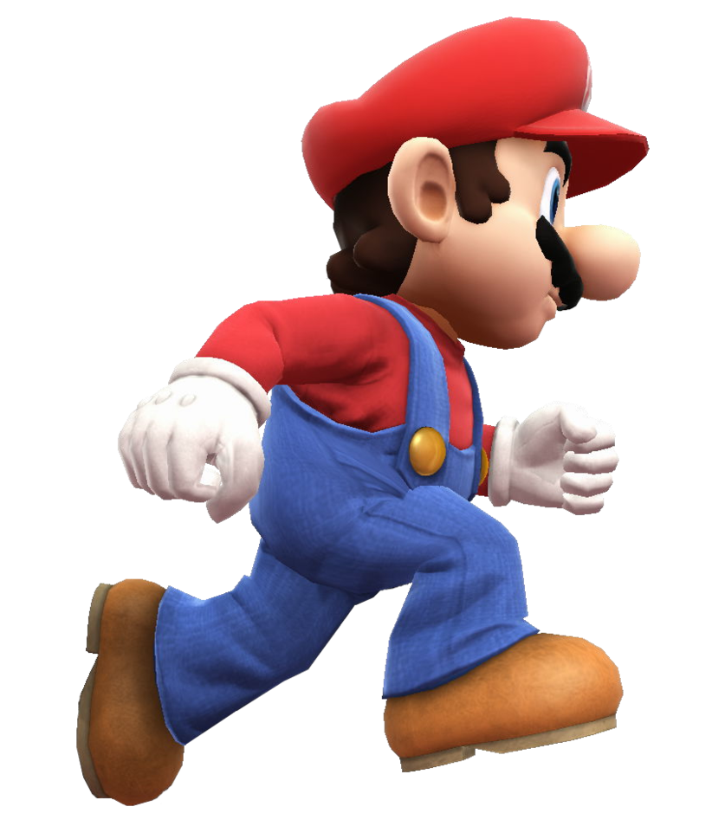
That’s it for now…
Any questions or clarification?
In the course webpage (https://moodle.ucl.ac.uk/course/view.php?id=22765) there is a challenge for you to be built over the course of these two lectures. The idea is for you to build a full “game” using PTB.
A description of the challenge can be found in the SuperMarioMatlabExercise_Tutorial document.
There is also a proposed solution in the same folder
And please don’t hesitate to contact me if you want to ask any ques

